Slide 1
Self-Assessment vs. Clinical-Assessment Models for Thyroid Cancer
Dan Huang, Yuchen Li, Zhenzhong Zhang, & Evan Rhodes
Notes:
ER

Slide 2
Background & Motivations
Notes:
ER

Slide 3
Disclaimer
Goals
We have made the classic mistake that was cautioned at the start of the semester; once we were deep into our analyses and reporting work, we realized that this is a case of clustered data over multiple visits, rather than longitudinal data
Show how GEE and GLMM fails in this context
Investigate original thoughts in GLM
Attempt to refine model with repeated visits under GLMM; compare to GLM
Notes:
ER

Slide 4
Thyroid Cancer
Increasing prevalence and mortality in recent decades due to improved medical technology and suspected environmental/lifestyle factors ¹
Nodules grow in neck region and are classified as benign (no major intervention typically) or malignant (cancerous, requires treatment)
If tumors suspected after physical examination, diagnostic procedures such as ultrasound, fine-needle aspiration, electrography, and common blood tests likely to follow
Notes:
ER

Slide 5
Potential Risk Factors: 3 Categories
Demographics / self-report aspects: Age, gender, family history, smoking history, height, weight, etc.
Diagnostic scans / clinical aspects: Scan texture entropy, nodule size & shape, thyroglobulin levels, presence of calcification
Wearable measurements / patient-accessible aspects: Heart rate, daily steps, daily sleep, estimated stress levels
Notes:
ER

Slide 6
Risk Factor Categories: Levels of Access
Demographics / self-report aspects: Easily obtained or known, requires little effort from the patient
Diagnostic scans / clinical aspects: Heavy patient burden, requires clinical visits & multiple tests
Wearable measurements / patient-accessible aspects: Moderate prevalence with growing popularity in smart technology
Notes:
ER

Slide 7
Ideal Model: Features from Each Source
Diagnostic scans can provide key information that have been found to increase malignancy risk ²
However, though beneficial, diagnostic scans are not fully reliable in differentiating malignant from benign nodules ²
Previous studies have found major disparities across demographic characteristics in risk of malignancy, particularly in gender ³
Hence, in this project we investigate how patients’ characteristics are associated with thyroid cancer outcomes.
Notes:
ER

Slide 8
Motivation
In practice, patients would want the best care possible for their situation and clinicians would want the most effective detection and treatment methods; the best model would include aspects from all three feature sources
However, some patients may not have reliable or quick access to clinical testing, left with only the features they may be aware of from self-assess and wearable categories
An early prediction model for public use utilizing only patient-known features may help reduce stress leading into clinical visits, allowing patients to have a somewhat better sense of what may be coming
Notes:
ER

Slide 9
Study Question
Can a model using only patient-known features (“self-assessment”) perform consistently with a model using only clinically measured features (“clinical-assessment”), in terms of predicting the probability of a malignant nodule?
Notes:
ER

Slide 10
Dataset Description
Kaggle “Multi Visit Thyroid Cancer Monitoring Dataset - SHD”
2 - 5 visits per patient across 80,000 unique patients
Data collected from January 2015 - March 2025, aggregated from participating healthcare centers & patient wearable device logs
No missing data; lack of documentation leaves caution in formal use, as we are unsure of any potential imputation or other missing data methods
Features binned into “self” or “clinical” assessment categories
Notes:
ER

Slide 11
Omit Cancer Subtypes
Thyroid cancer can be further categorized into papillary, follicular, medullary, or anaplastic subtypes, each with differing pathologies and prevalences
For the purposes of our study question, want to consider the overall presence of any cancer, regardless of subtype; for a patient, presence/absence of cancer is assumed to be more immediately relevant than the specific type of cancer
A subtype sensitivity analysis could be an interesting follow-up, but for this project we only investigated logistic models for binary malignancy status
Notes:
ER

Slide 12
Methods: Self-Assessment Model
Notes:
DH

Slide 13
Aim
How are demographic and self-assessment characteristics associated with the probability of "Malignant"?
Outcome: Diagnosis_Label (0: Benign, 1: Malignant)
Predictors
Demographics: Age, Gender, BMI, Family_History, Smoking_Status, Radiation_Exposure
Time varying self-assessment: Heart_Rate, Daily_Steps, Sleep_Patterns, Body_Temperature, Pulse_Oximetry, Stress_Level, Symptom_Onset_Duration, Medication_Adherence
Time Effect: Visit_Number (as a numeric variable)
Notes:
DH
We’re looking at how demographic and self-assessment features relate to whether a patient is malignant or benign. These features include age, gender, BMI, family history, and wearable-based measures like heart rate, steps, sleep, stress, and so on.

Slide 14
Base Model
Diagnosis_Label ~ Age_c + Gender + BMI_c +
Family_History + Smoking_Status + Radiation_Exposure +
HR_c + Steps_c + Sleep_c + Temp_c + SpO2_c +
Stress_c + SymptomDur_c + Adherence_c +
Visit_Number
Notes:
DH

Slide 15
Analysis Plan - GLM & GEE
Setup
Center and scale continuous variables
Visit_Number treated as numbers
Use Patient_ID as the grouping factor.
GLM (Assume within-subject independence)
Fit logistic GLM & report ORs and 95% CIs
Check assumption: Deviance residuals vs fitted
GEE
Exchangeable working correlation & ORs and robust SEs
Report working correlation (α)
Sensitivity: Independence GEE + AR-1 comparison with Exchangeable
Check assumption: Pearson residuals vs fitted
Notes:
DH
We analyze the data using GLM, GEE and GLMM.
First, all the continuous variables were scaled and centered.
For the GLM model, it assumes independence between visits for each patient.
GEE normally accounts for within patient correlation, but here the outcome never changes, so GEE can’t really estimate a meaningful correlation structure.

Slide 16
Analysis Plan - GLMM
Model Specification
Fit Random Intercept Logistic GLMM:
Formula: Diagnosis ~ Visit_Number + Covariates + (1 | Patient_ID)
Method for simulation: maximum likelihood (Adaptive Gauss-Hermite Quadrature, nAGQ = 0)
Note: While this method may yield inaccurate estimations, we utilize nAGQ = 0 due to the large dataset size.
Reporting Metrics
Subject-Specific Odds Ratios: Conditional on random effects.
Random Effect Variance: Quantify between-subject variability, ICC to check random effect variance and overall variance.
Assumptions: Pearson Residuals, Q-Q Plot
Notes:
ZZZ "For GLMM, we fit a Random Intercept Logistic GLMM.
We modeled the diagnosis outcome against Visit Number and key covariates, and a random intercept to account for the correlation within each patient.
A critical technical detail to note is that we used nAGQ = 0 for estimation. Given the massive size of our dataset, standard methods were too computationally intensive.
Finally, we will report subject-specific Odds Ratios and use the ICC to quantify how much variation comes from patient differences, while checking our assumptions with pearson residual plots and qq plot."

Slide 17
Methods: Clinical-Assessment Model

Slide 18
Feature Selection: Diagnostic Scans
From scan images, facets of elasticity, microcalcifications, and irregular margins can be indicative of increased malignancy risk ²
Tumor size and shape are established predictors of malignancy ^{2, 3}
Echogenicity, a measure of how well certain tissues can reflect waves from ultrasound imaging has been recommended as a diagnosis factor ⁵
Scan entropy is a statistical representation of intratumor heterogeneity that have been shown to be associated with gene-expression patterns; patterns used to help guide treatment decisions ⁶
Notes:
ER

Slide 19
Feature Selection: Blood Tests
Measurements of thyroid-stimulating hormone (TSH), which has been presented in recent studies as providing additional information to predict malignancy, since it can promote carcinogenesis on thyroid tissue ⁴
Thyroid peroxidase antibodies (TPOAb) and thyroglobulin antibodies (TGAB) have also been noted to potentially assist in diagnosing malignant thyroid tumors ⁷
Notes:
ER

Slide 20
Data Pre-Processing
All non-categorical features were centered & scaled before proceeding with analyses
Coefficient estimates can be compared on centered & scaled predictors since we have instilled consistent interpretations, helping obtain a crude measure of the “most influential” risk factors
Several risk factors bounded on small scales (0 - 1), so this additionally helps with general interpretations
Dummy variable coding for binary and categorical variables
Notes:
ER

Slide 21
Final Model Components
Outcome: Binary indicator, 0 = Benign, 1 = Malignant (we will be modeling the probability of a patient receiving a malignant diagnoses, i.e. coefficients > 1 will have negative patient impacts as they grow)
Fixed effects:
Continuous nodule size, shape, margin sharpness, echogenicity, and texture entropy
Binary indicators for presence of calcification of capsular invasion (breach of cancer cells)
Categorical low/medium/high risk of hypothyroidism (based in TSH concentration)
Continuous TPOAb & TGAB
Notes:
ER

Slide 22
Generalized Estimating Equation (GEE) Approach
Initial model; good robust approach for exploratory analyses
Assume exchangeable/compound symmetry correlation structure, then plot Pearson residuals to observe the empirical correlation structure across visit lag times
Adjust to AR(1) correlation structure if it appears more appropriate based on empirical correlation plot
Review Pearson & deviance residuals to ensure adequate model fit and correctly specified mean/variance structures
Notes:
ER

Slide 23
Generalized Estimating Equation (GEE) Approach
Compare GEE to subsequent models using AIC/BIC
Use results to guide exploratory comparisons with the self-assessment model
We notice little within-subject variability from the downloaded Kaggle dataset, benign/malignant status does not change over time; we expect that GEE may struggle in this context, since the estimating equations require a certain level of variability
Notes:
ER

Slide 24
Generalized Linear Model (GLM) Approach
Subset data to only the baseline visit
Major assumption: a participant’s measurements at their first visit should be indicative of tumor status, given that tumor status did not change over time
By subsetting the data, we are now covering GLM assumptions that all observations are independent
We may likely be introducing some bias with this approach, but the goal is to have more indicative true population-level effect than GEE might provide
Fit GLM model with default logit link & review Pearson & deviance residual plots to ensure appropriate fit
Compare to GEE & GLMM with AIC/BIC
Use results to guide exploratory comparisons with the self-assessment model
Notes:
ER

Slide 25
Generalized Linear Mixed Model (GLMM) Approach
Performance Metrics
Goodness-of-Fit Comparison: Use Akaike Information Criterion (AIC) to compare model fit.
Hypothesis: Lower AIC in Model 2 confirms clinical features' superior explanatory power over demographics.
Significance Testing:
Model 1 Strategy: Test demographic fixed effects for significance to validate their utility as risk proxies.
Model 2 Strategy: Evaluate significance of clinical drivers to confirm biological plausibility.
Investigating Unmeasured Heterogeneity
Analysis of Random Effects : Estimate variance of the subject-specific random intercept.
Research Question: How much does unmeasured individual heterogeneity drive the risk profile?
Interpretation Strategy:
High estimate variance of random effects in Model 1 suggests baseline risk is more important than wearables.
Assess if adding clinical features in Model 2 reduces this unexplained variance.
Notes:
ZZZ： The methods for GLMM for clinical assessment is same as the self-assement one. We will also assessing Performance and investigating Heterogeneity between two models.
First, for performance, we use AIC to compare model fit. Our hypothesis is that Model 2 will demonstrate superior explanatory power over the demographics-only Model 1. We will also test the significance of both demographic and clinical fixed effects to validate their utility as risk drivers.
Second, we are deeply interested in unmeasured heterogeneity. By estimating the random intercept variance, we can quantify baseline risk differences between patients. A key question is whether adding clinical features in Model 2 reduces this unexplained variance, which would indicate we have successfully captured those underlying risk factors."

Slide 26
Generalized Linear Mixed Model (GLMM) Approach
Assumptions Check:
Pearson Residuals, Q-Q Plot
Model superiority will be determined by:
Statistical Validity: Better satisfaction of linearity and normality assumptions.
Predictive Capability: Identification of actionable, significant predictors over unobserved heterogeneity.
Notes:
ZZZ：Finally, to validate our modeling choices, we conduct a thorough Assumptions Check using Pearson residuals and Q-Q plots.
Ultimately, we will determine model superiority based on two criteria: Statistical Validity and Predictive Capability. We are looking for a model that identifies actionable, significant predictors rather than leaving the risk profile explained by unobserved heterogeneity.

Slide 27
Results: Self-Assessment Model
Notes:
DH

Slide 28
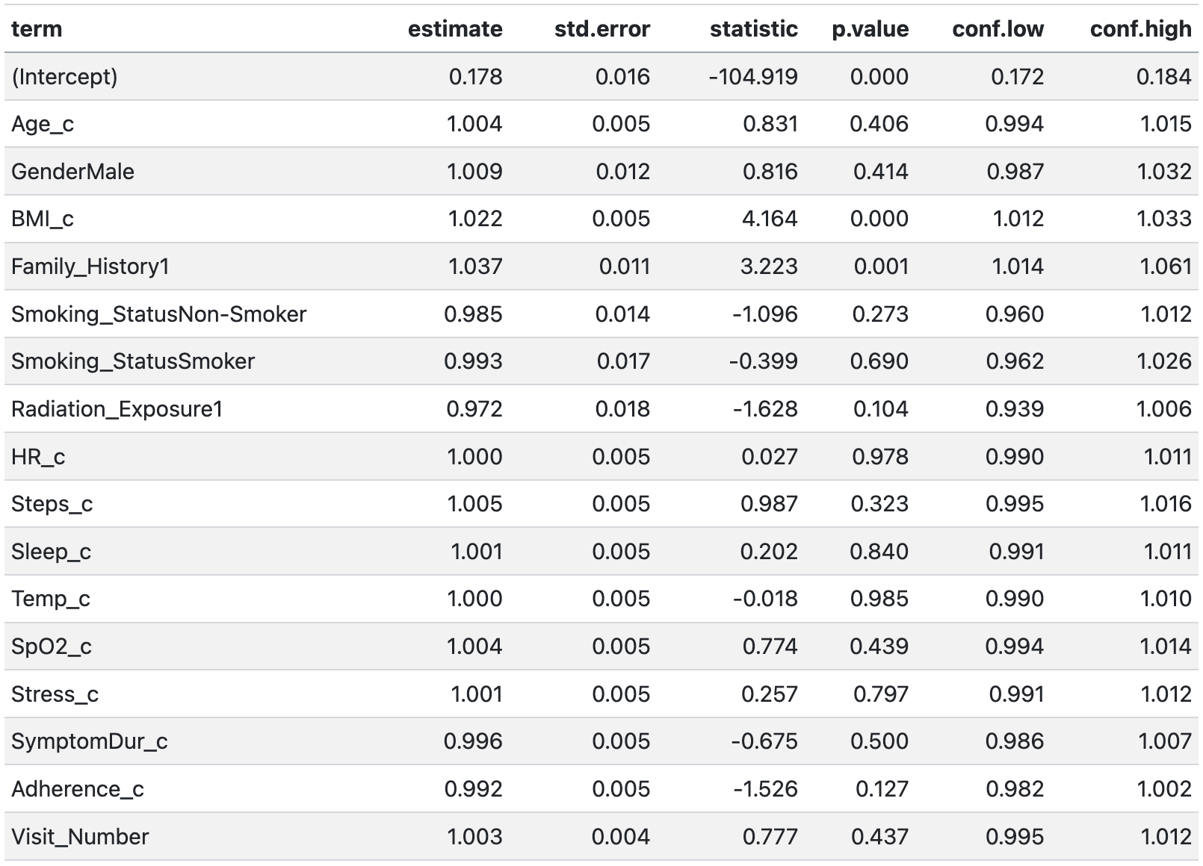
GLM - Logistic GLM Exponentiated ORs + 95% CIs
Significant predictors: BMI, Family History
Associations are small
Oversampling cases with many visits
Reflects how characteristics & self-assessment measures differ between patients with cancer vs. without cancer
Notes:
DH

Slide 29
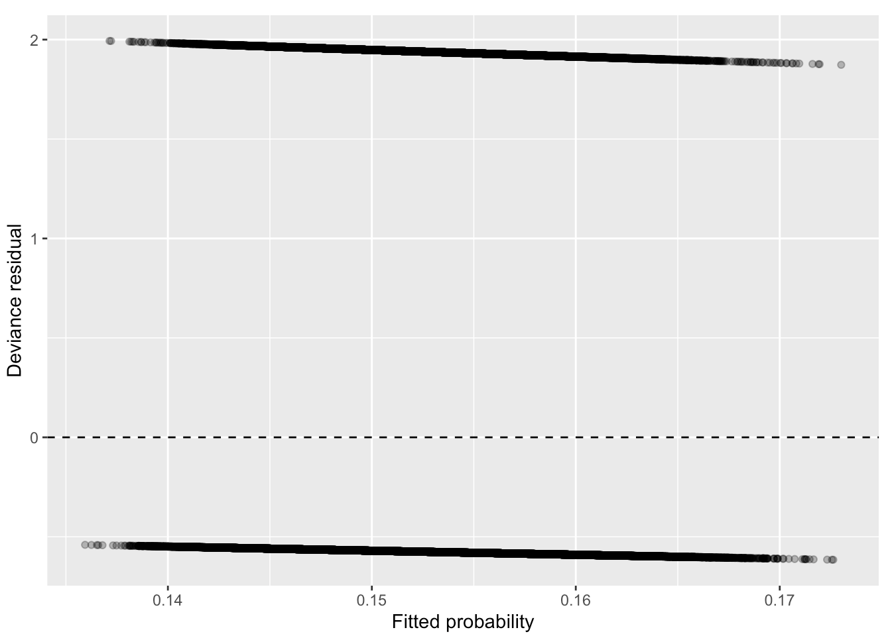
GLM - Deviance residuals vs fitted
Two lines with no curvature / patterns -> no lack of fit
Linearity✅
Homoscedasticity✅
Independence❌
Fit GLM for comparison with GEE and GLMM
Notes:
DH

Slide 30
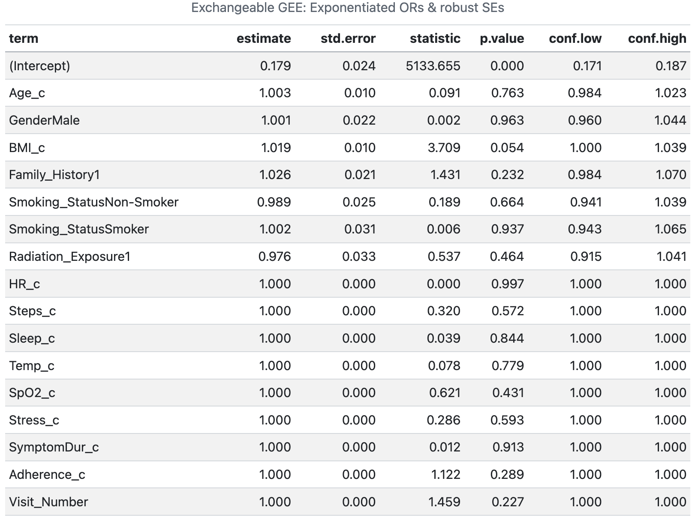
GEE
Alpha = 1.002
Within-subject outcomes have no variation / correlation can't be estimated
No significant predictor
Notes:
DH

Slide 31
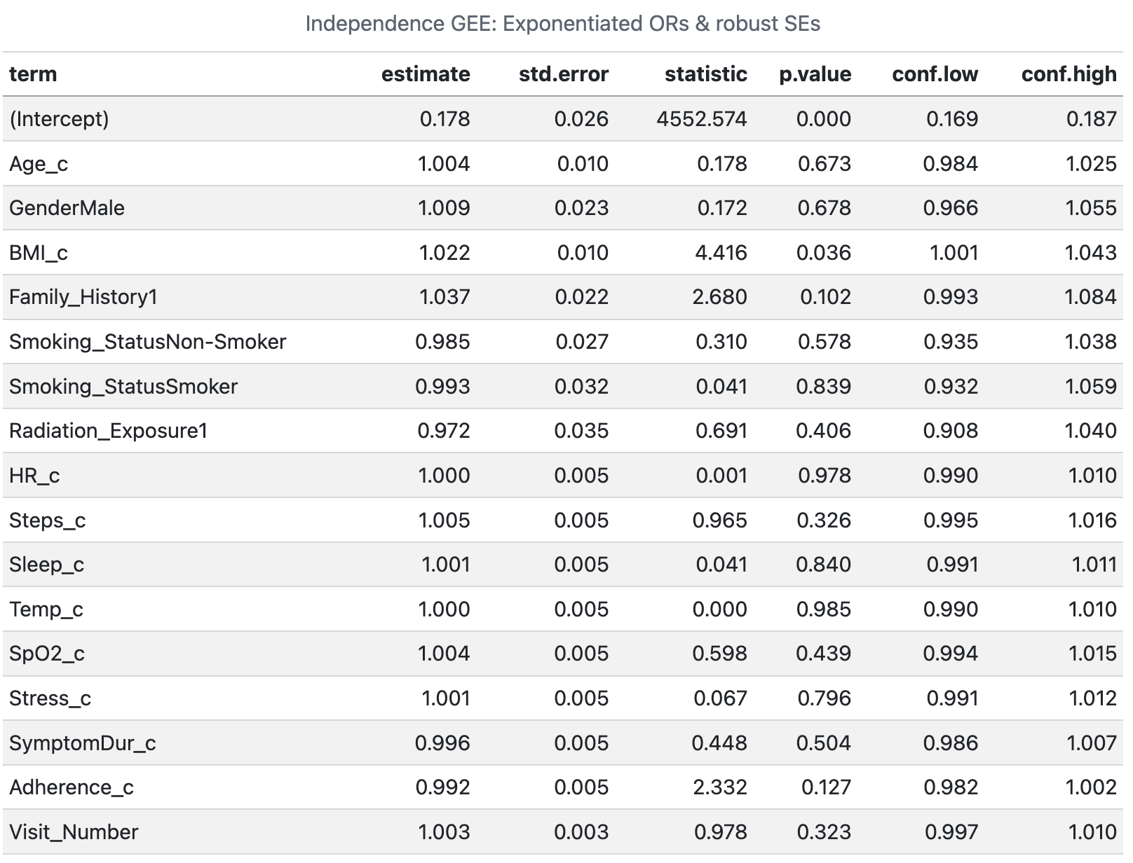
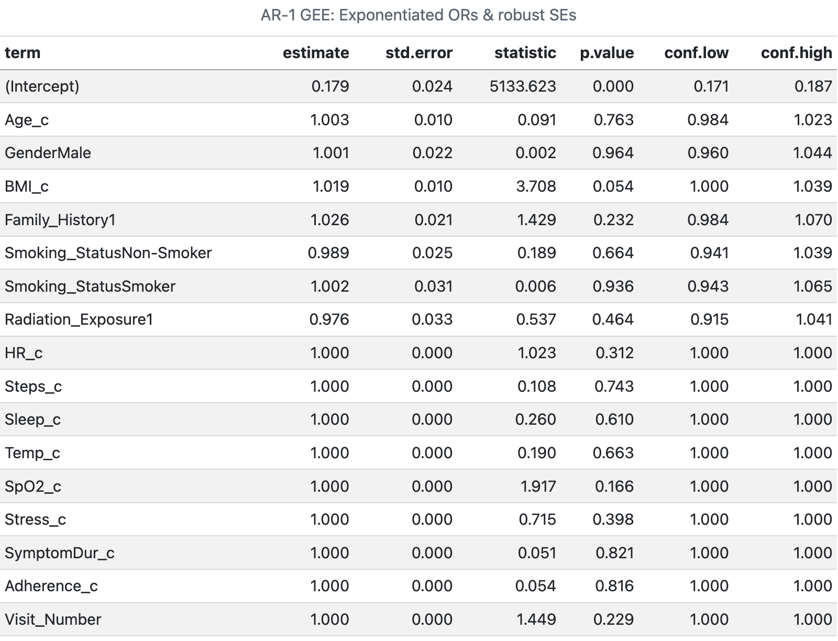
GEE - sensitivity
ORs and 95% CIs are almost identical for exchangeable, independence, AR-1 -> not sensitive to choice of structure; Independence model: BMI is significant;
Notes:
DH

Slide 32
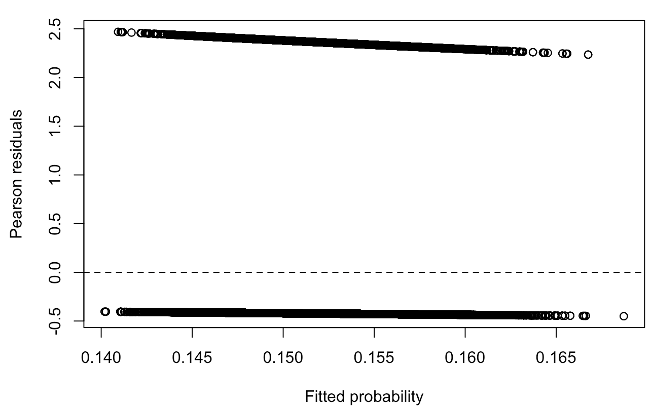
GEE - Pearson residuals vs fitted
No strong pattern -> The model is reasonably specified
N = 80000 -> Large sample approximation for the robust standard errors is reliable
Notes:
DH

Slide 33
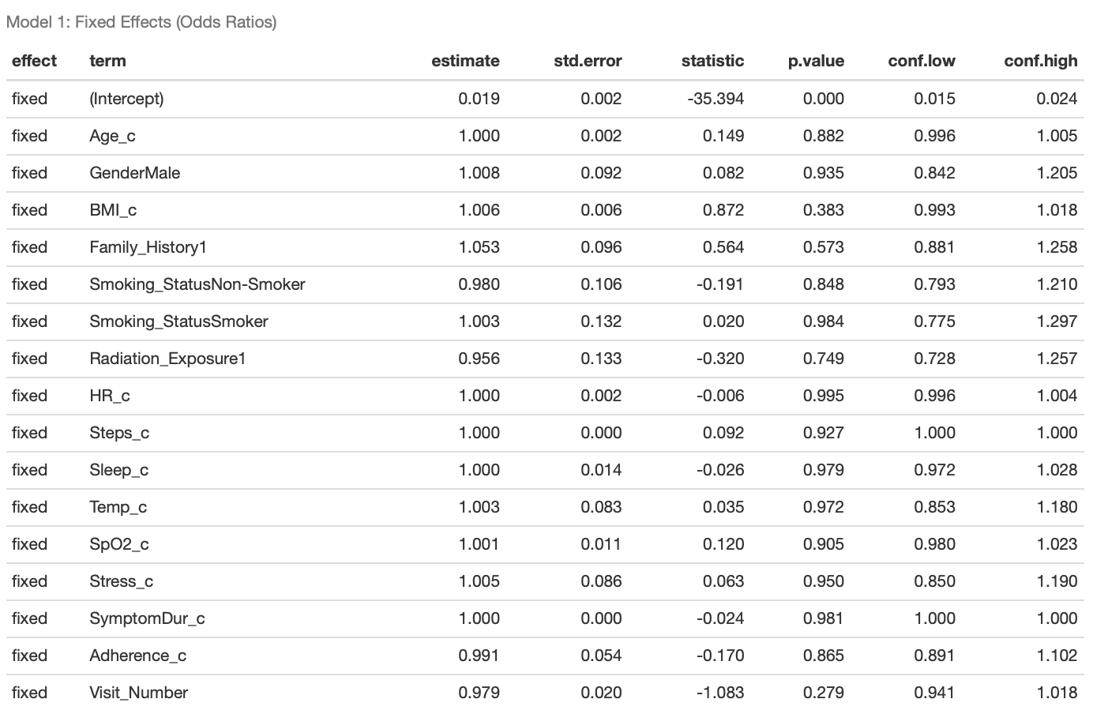

GLMM - Estimated Odd Ratios
Only intercept are significant,
No significant predictors
The variance of the random effects is 86.57 (sd = 9.3), and ICC is 0.963, indicating random effects explain most variance of the data.
Notes:
ZZZ："Here are the results for Model 1.
Surprisingly, only the intercept is significant; none of the demographic predictors showed statistical significance.
However, the random effects variance is enormous at 86.57, yielding an extremely high ICC of 0.963. This tells us that nearly all the variation in diagnosis is driven by unmeasured differences between patients, rather than the demographic variables we included. This strongly motivates the need for Model 2."

Slide 34
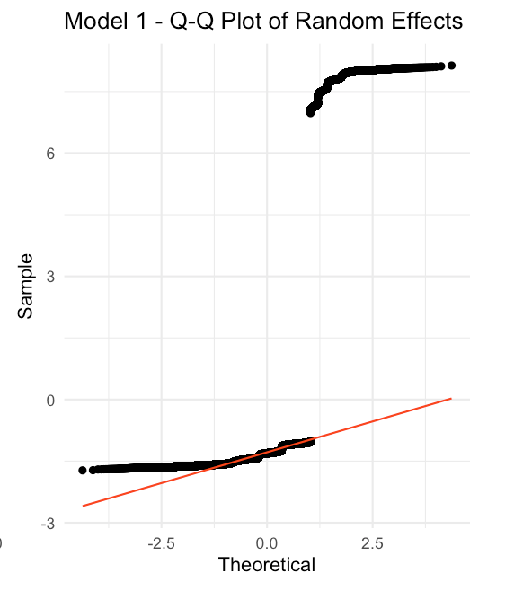
GLMM - QQ plot
The QQ plot show that the random intercepts gather at -1.5 and 8.
The distribution of the random random effect looks like binormal, conforming the invariance of outcome over time.
Assumption check: the random effects do not following normal distribution.
Notes:
ZZZ: We see a clear approximate binomial distribution—two separate clusters of random effects. One cluster corresponds to patients who are always 'benign' and the other to those always 'malignant'.
This violates the normality assumption of the random effects. It confirms that we don't have a continuum of risk, but rather two distinct populations that our current predictors—demographic or clinical—cannot differentiate.

Slide 35
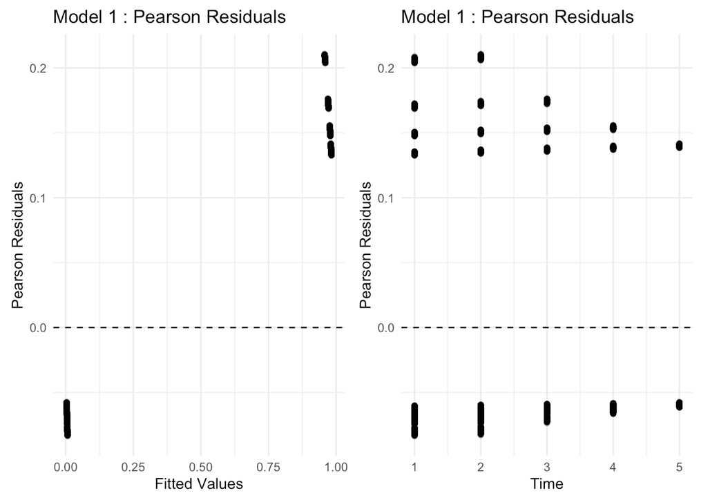
GLMM - Pearson residuals
Most Pearson residuals fall between -0.1 and 0.3.
The models fit the data very well over time.
Notes:
ZZZ："Looking at the diagnostic Q-Q plot for the random effects, we see a distinct separation into two clusters around -1.5 and 8.
This bimodal distribution suggests the random effects are not normally distributed, violating a key assumption. Instead, it indicates our patient population is likely splitting into two distinct latent groups—perhaps 'high risk' and 'low risk'—that our current demographic predictors fail to capture."

Slide 36
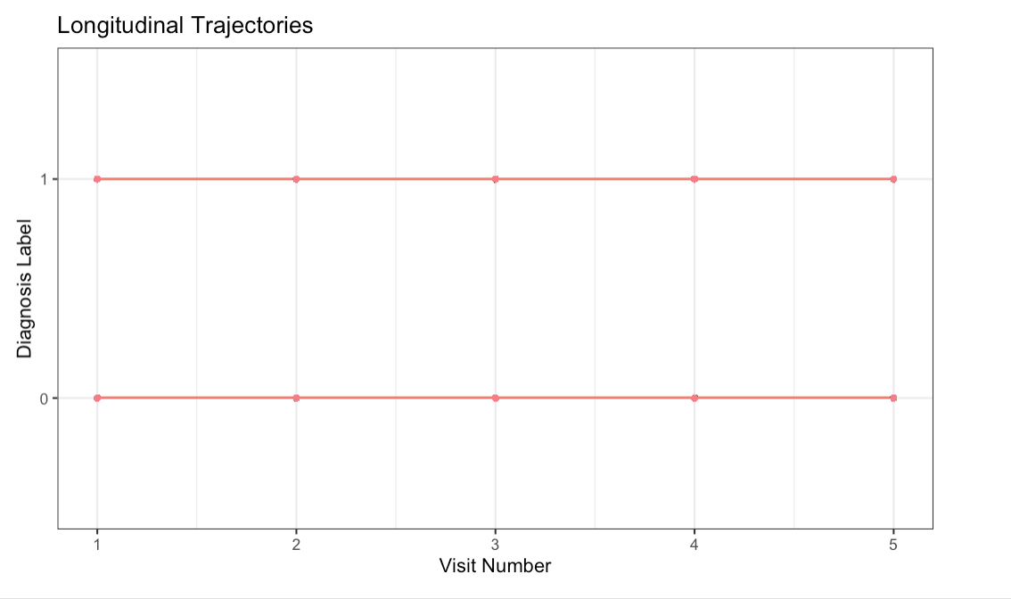
GLMM - Longitudinal Trajectories
The plot show that the diagnosis label of a certain patient does not change over time.
Explain the high variance of random effects and high p-value of coefficients of covariates.
Suggests GLM
Notes:
ZZZ： "To understand why our models failed to explain this variance, we plotted the longitudinal trajectories for individual patients.
As you can see, the diagnosis label for any given patient is essentially static. It does not change over time. Patients are either always 'benign' (0) or always 'malignant' (1) throughout the study.
This explains the enormous random effects variance: the model is trying to fit a longitudinal curve to data that has no longitudinal variation within patients. It effectively collapses into a cross-sectional problem where 'who the patient is' determines 100% of the outcome."

Slide 37
Results: Clinical-Assessment Model

Slide 38
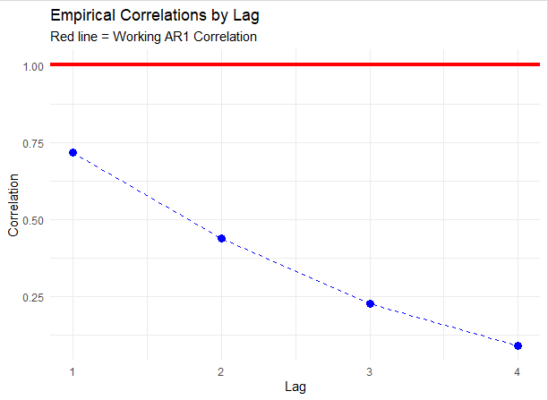
GEE: Empirical vs. Working Correlations
AR(1) ultimately selected after observing the empirical correlations structure by lag
GEE fails: working correlation estimated as =1, subject visits are perfectly correlated
Due to malignant/benign status not changing over time
Notes:
ER

Slide 39
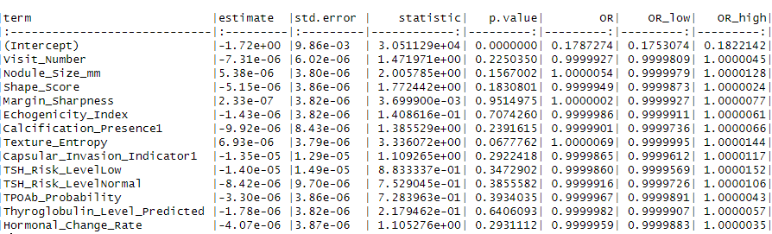
GEE: Final AR(1) Model Results
Notes:
ER

Slide 40
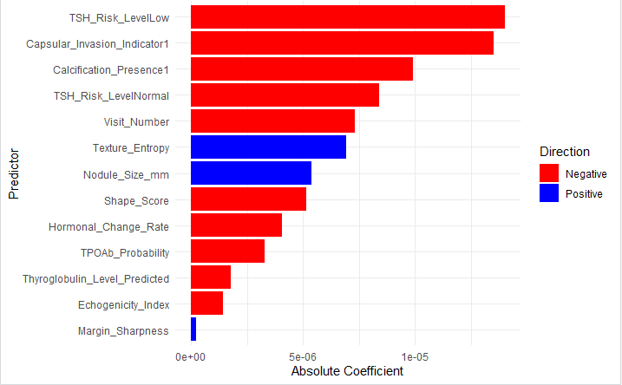
GEE: Ranked Features by Estimate Absolute Value
Notes:
ER

Slide 41
GEE: Results Interpretation
Majority of coefficients estimate an odds ratio of 1 or very close to 1; not a particularly helpful model
As discussed, GEE is a poor choice for this problem context
Plot of centered & scaled coefficient estimates likely just reflects some random noise in our model; largest coefficient was -0.00014
Notes:
ER

Slide 42
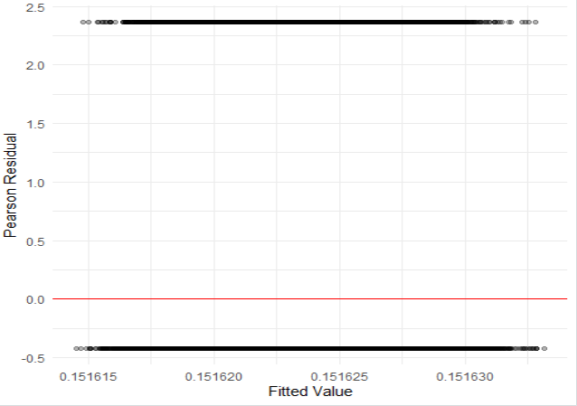
GEE: Pearson Residual Plot
Model predicts near constant probability for malignancy depending on benign/malignant status
Drastically underestimates risk of malignancy for those who actually are malignant
Evidence of poor context for GEE model
Notes:
ER

Slide 43
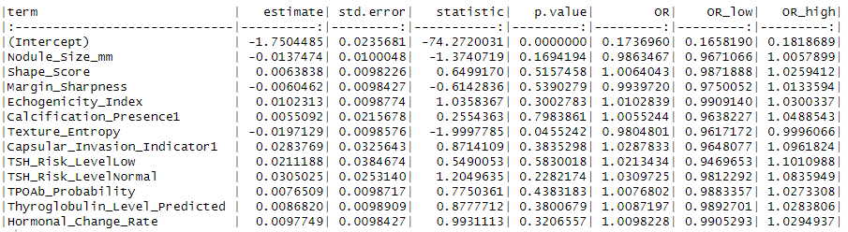
GLM: Final Logistic Model Results
Notes:
ER

Slide 44
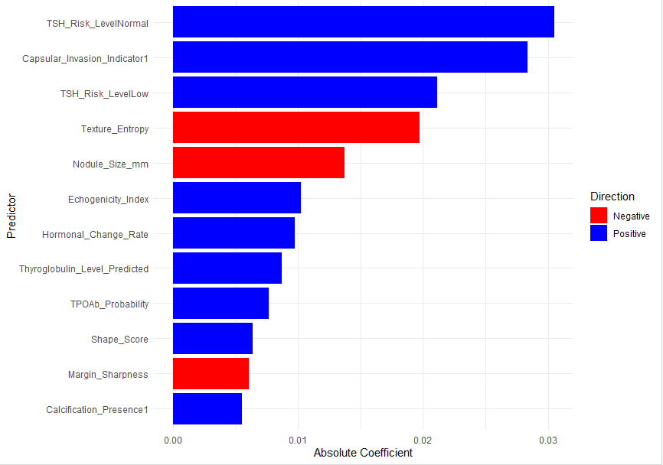
GLM: Ranked Features by Estimate Absolute Value
Notes:
ER

Slide 45
GLM: Results Interpretation
GLM baseline model much more helpful for identifying potential risk factors! Since we have subset to the patient’s first visit, no violation of the independence assumption
Findings somewhat corroborate literature; for example presence of capsular invasion (spread of cells to other areas) largely influences risk of malignancy
Some predictors inconsistent with literature; for example, we would expect risk of malignancy to increase with nodule size, though our model shows a negative relationship
Notes:
ER

Slide 46
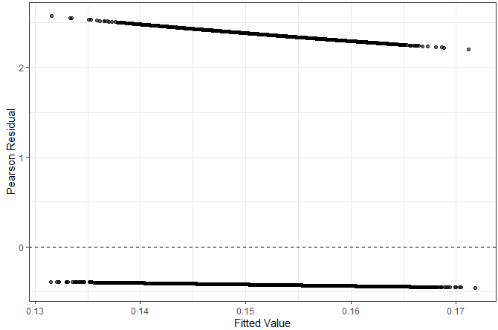
GLM: Pearson Residual Plot
More representative of what we might expect from logistic regression when compared to GEE
Assumed mean & variance structures appear adequate
Still observing under-estimation in probability of malignancy for those who have it
Notes:
ER

Slide 47
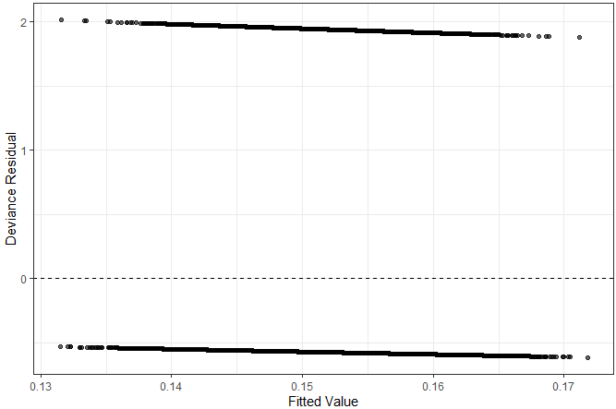
GLM: Deviance Residual Plot
Similar comments as Pearson residuals plot
Indicates that our model struggles more for those who do actually have malignant tumors
Notes:
ER

Slide 48
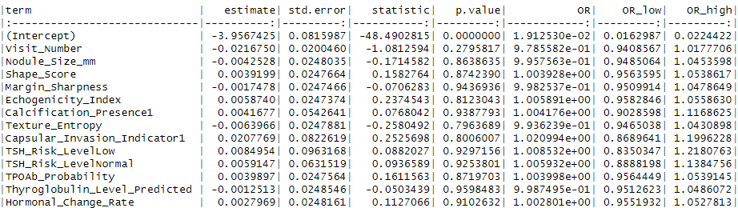
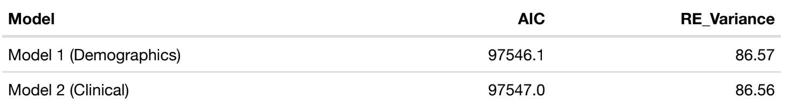

GLMM Results
Notes:
ZZZ: Here are the GLMM results for Model 2
The outcome is similar to the model 1. Looking at the coefficient table, despite adding clinically relevant variables like Nodule Size, Shape Score, and TSH Levels, none of them achieved statistical significance.
The comparison table at the bottom confirms this lack of improvement. The AIC values are virtually identical between the Demographics-only model and this Clinical model.
Most critically, the Random Effects Variance did not drop; it remained at approximately 86.6. This indicates that these clinical features failed to explain the between-patient variation any better than demographics did. The high ICC of 0.963 persists, suggesting that the risk profile is still almost entirely determined by unmeasured latent factors specific to each patient, rather than these clinical markers.

Slide 49
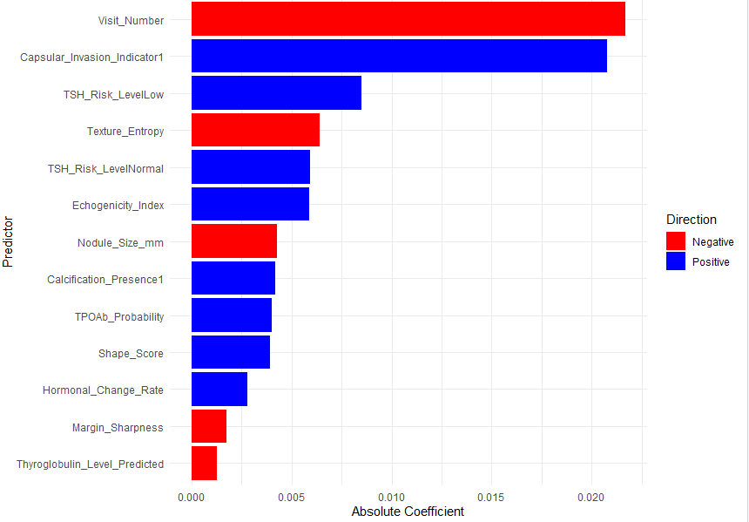
GLMM: Ranked Features by Estimate Absolute Value

Slide 50
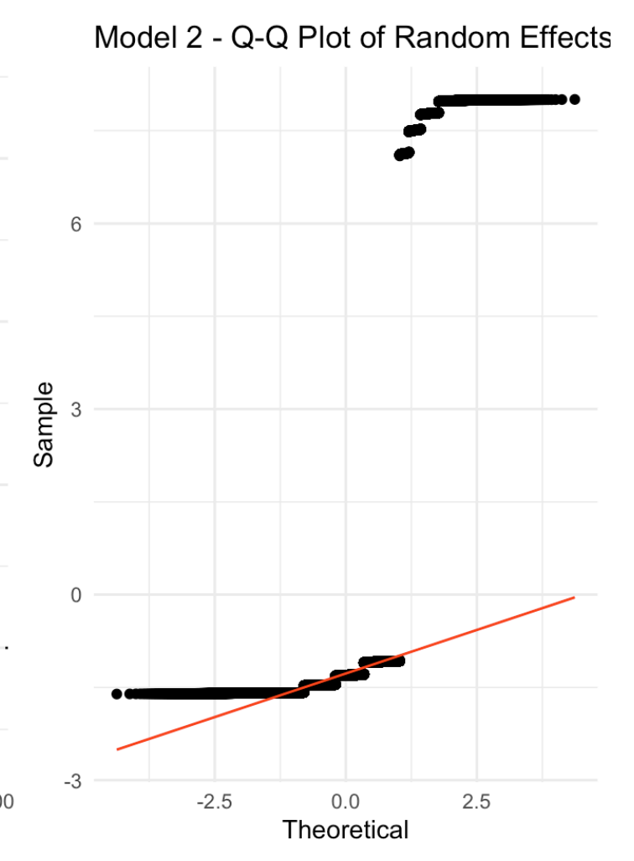
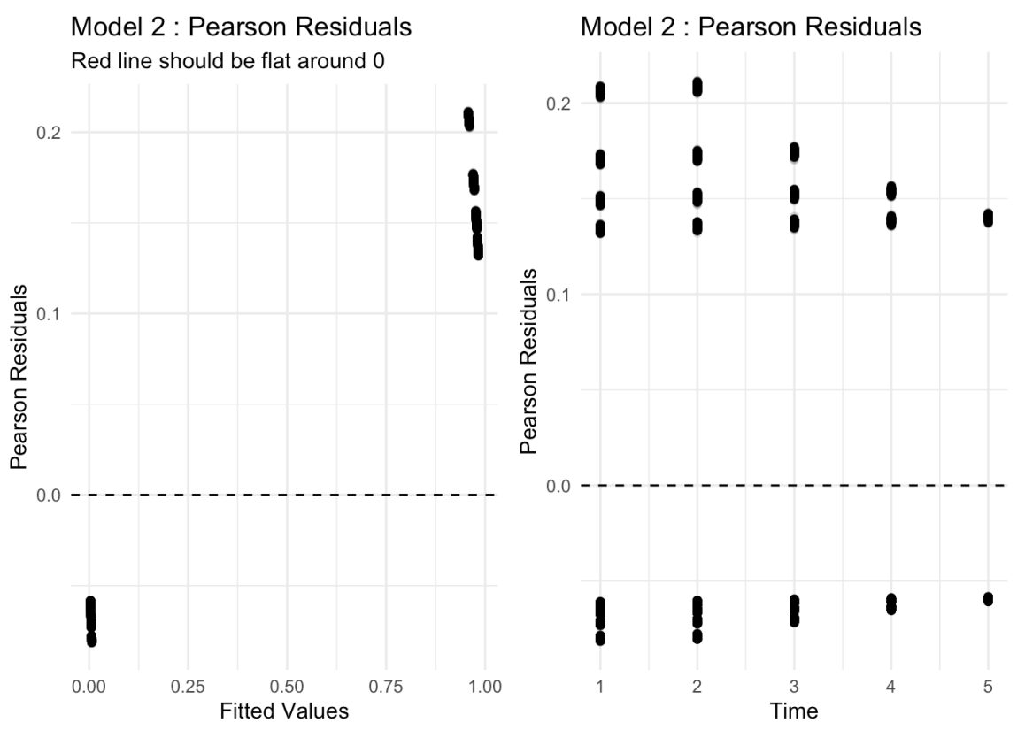
GLMM - QQ plot and Pearson Residuals
The QQ plot of random effects for the Clinical-Assessment Model also show violation of Normal assumption of random effects.
The Pearson residuals v.s. fitted values plot still indicate a good fit of the model
GLM would provide better prediction in this situation.
Notes:
ZZZ: Finally, looking at the diagnostics for Model 2, the issue persists.
The Q-Q plot (left) remains bimodal, confirming that even with clinical variables, the random effects do not follow a normal distribution. While the residuals (right) show a good mathematical fit, the violation of the normality assumption—combined with the static nature of the outcome—leads us to conclude that a GLM (standard Logistic Regression) would be a more appropriate and robust approach than GLMM for this specific dataset."

Slide 51
GLMM: Results Interpretation
Random intercept introduced to allow varying subject characteristics at baseline
Estimated effects provide an individual level scale
Visit number associated with decreased risk of malignancy; a very loose interpretation / attempt to guess at what’s happening here is that participants with a higher frequency of visits more likely pursue and adhere to preventative care than those with a smaller frequency of visits, identifying potential malignancies earlier

Slide 52
Results: GLM vs GEE vs GLMM

Slide 53
Theoretical Expectations
With no variation in our observed outcome over visits, we should not expect to see GEE perform well
Assuming baseline visit status is indicative of the true time benign/malignant tumors were observed, a GLM filtered to this initial visit will give helpful population-level inference
GLMM can account for correlation among repeated measures in a subject by including a random intercept; HOWEVER, since the outcome does not vary, our random intercept reflects the unexplained between-subject differences, improving precision rather than providing subject-level estimates
Notes:
YL

Slide 54
Model comparison
 | Self-assessment | Clinical
GLM | Estimates are similar to GEE; Within-patient correlation wasn’t accounted (assumed independence) & repeated measures -> Smaller SEs + identified BMI and family history as significant predictors | Ideal model for problem context. Estimates are larger in general when compared to GLMM; texture entropy identified as significant predictor. Capsular Invasion & TSH influential.
GEE | No significant predictor. alpha = 1-> correlation can't be estimated Larger SEs compared to GLM | Not worth discussing – model fails in this context due to perfect correlation.
GLMM | More variability than GLM because random effects accommodate patient-level differences. Similar overall findings compared to GLM. | Violation of normal assumption of random effects – not worth discussing.
Notes:
YL

Slide 55
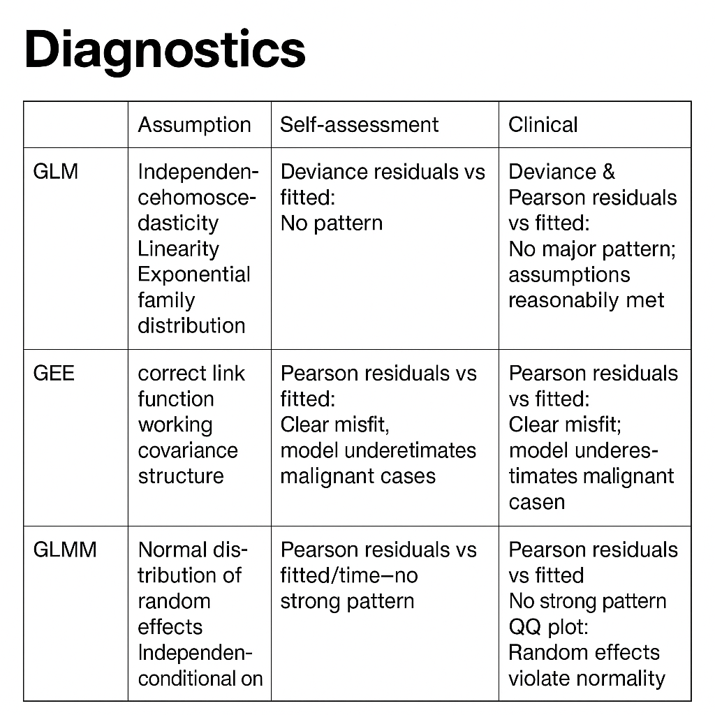
Notes:
YL

Slide 56
Results
Clinical > Self for predictive strength and interpretability
Self model: only BMI, family history signal; weak overall
GEE fails: outcome constant → α ≈ 1, no usable correlation
GLMM ≈ GLM: minimal within-patient variation; random effects add little
Best model: GLM (matches clustered-not-longitudinal structure)
Clinical features: capsular invasion, TSH risk, calcification, entropy stand out
Outcome static → limits all longitudinal methods
Notes:
YL

Slide 57
Discussions

Slide 58
Why GLMM ≈ GLM in our analysis
Both models produced nearly identical estimates and SEs.
The random intercept variance in the GLMM was very small -> large, indicating minimal within-patient clustering.
Our visits do not represent a true longitudinal trajectory—the outcome does not evolve across time.
Predictors vary by visit, but the outcome is essentially static, weakening the correlation structure.
With weak intra-patient correlation, the GLMM collapses toward the marginal GLM.
As a result, GLMM barely offered any additional explanatory power beyond GLM.
Notes:
YL

Slide 59
Limitations
Outcome is constant within each patient
GLM treats repeated visits as independent
Scan quality may vary across centers and scan types
misclassification of Diagnosis_Label
Self-assessment measures may be inaccurate
Models rely on simplifying assumptions
GLM: independence
GEE: working correlation structure
GLMM: random effects ~ N
Limited dataset documentation
Data cleaning/preprocessing
Missing data handling
Notes:
YL

Slide 60
Future Steps
Incorporate thyroid cancer subtypes (Cancer_Type)
Combine self-assessment and clinical models
Model time more carefully
Replace visit time with exact time since baseline
Improve model complexity
Add interactions
Account for center differences
Split analysis by center
Notes:
YL

Slide 61
References
Pellegriti, Gabriella, et al. “Worldwide Increasing Incidence of Thyroid Cancer: Update on Epidemiology and Risk Factors.” Journal of Cancer Epidemiology, vol. 2013, 2013, pp. 1–10. DOI.org (Crossref), https://doi.org/10.1155/2013/965212.
Usefulness of Different Ultrasound Features of Malignancy in Predicting the Type of Thyroid Lesions: A Meta‑analysis of Prospective Studies. https://doi.org/10.20452/pamw.2132. Accessed 26 Nov. 2025
Gu, Jianhua, et al. “A Machine Learning-Based Approach to Predicting the Malignant and Metastasis of Thyroid Cancer.” Frontiers in Oncology, vol. 12, Dec. 2022, p. 938292. DOI.org (Crossref), https://doi.org/10.3389/fonc.2022.938292.
Ross, Douglas S. “Predicting Thyroid Malignancy.” The Journal of Clinical Endocrinology & Metabolism, vol. 91, no. 11, Nov. 2006, pp. 4253–55. DOI.org (Crossref), https://doi.org/10.1210/jc.2006-1772.
Wu, MH., Chen, CN., Chen, KY. et al. Quantitative analysis of echogenicity for patients with thyroid nodules. Sci Rep 6, 35632 (2016). https://doi.org/10.1038/srep35632
Incoronato, Mariarosaria, et al. “Radiogenomic Analysis of Oncological Data: A Technical Survey.” International Journal of Molecular Sciences, vol. 18, no. 4, Apr. 2017, p. 805. DOI.org (Crossref), https://doi.org/10.3390/ijms18040805.
Li, Luchuan, et al. “Positive Thyroid Peroxidase Antibody and Thyroglobulin Antibody Are Associated With Better Clinicopathologic Features of Papillary Thyroid Cancer.” Endocrine Practice, vol. 27, no. 4, Apr. 2021, pp. 306–11. DOI.org (Crossref), https://doi.org/10.1016/j.eprac.2020.10.017.

